Slide 1

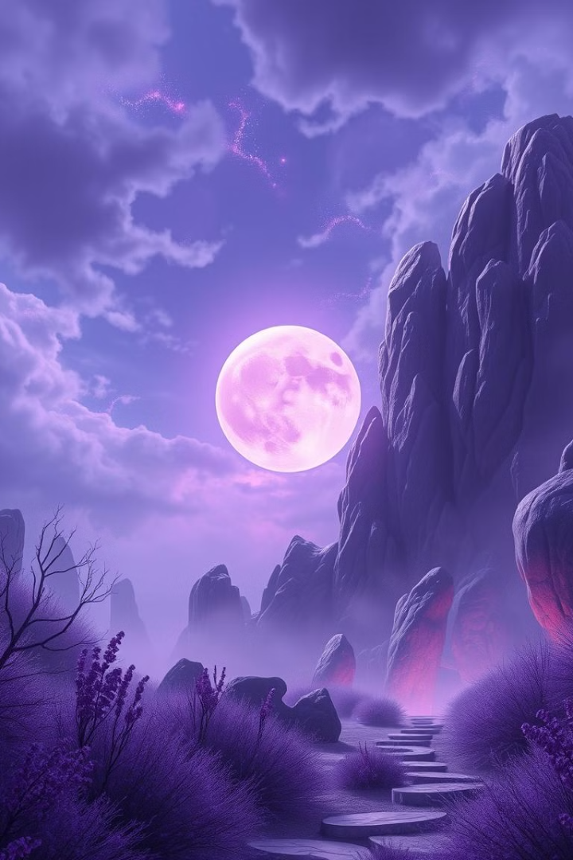

Story Generator with AI-Generated Images
Created by Najla salah .ali mahmood on 2025/1/2
This presentation explores the creation of a fantasy adventure story using AI to generate visuals that seamlessly align with the narrative, bringing the world and characters to life.

Slide 2
Introduction
Project Goal
Key Areas
Generate a captivating fantasy story centered around a young scholar's discovery of a powerful artifact, accompanied by visually stunning AI-generated images.
This project involved prompt engineering, image generation, and aligning visuals with the story's plot points and characters.

Slide 3
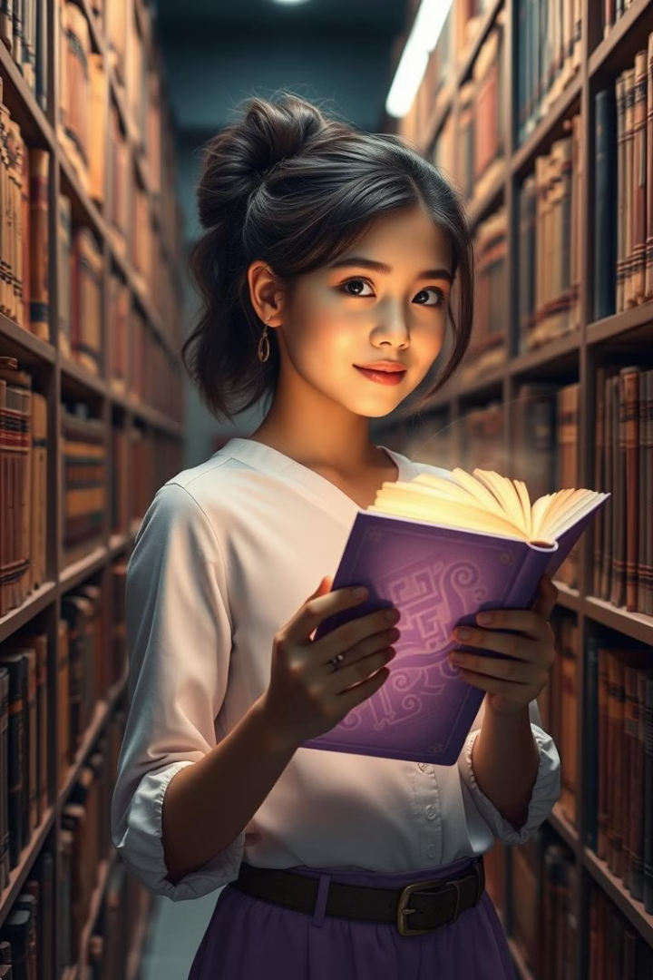
Initial Prompt Design
Ariella, a young scholar, discovers an ancient spellbook in a forgotten library. The book reveals a powerful artifact hidden in a treacherous land. Ariella embarks on a quest to find the artifact, facing dangerous creatures and challenging puzzles along the way. She must learn to harness the artifact’s power to save her world from a malevolent force.

Slide 4
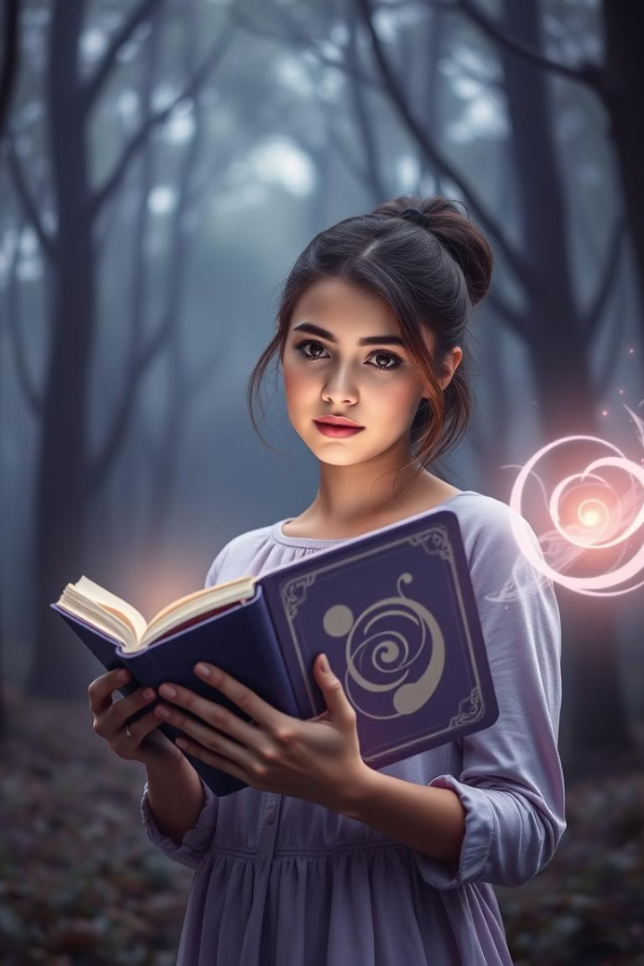
Iterating on the Prompt
1
Prompt 2
2
Prompt 3
Added details about Ariella's personality, the artifact's unique powers, and the antagonist's motivations.
Further refined the prompt, incorporating a redemption arc for a supporting character and deepening the antagonist's backstory.

Slide 5
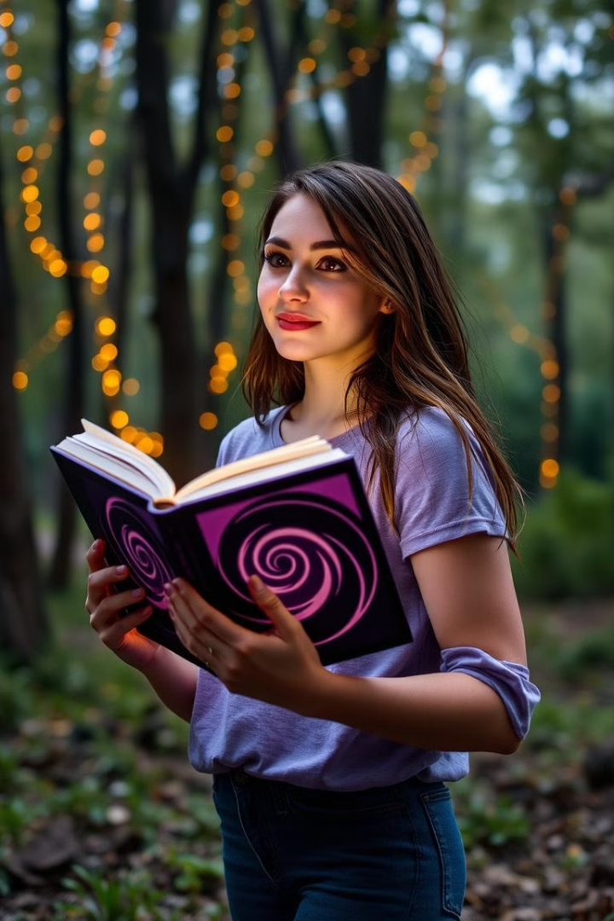



AI Image Generation
Spellbook Discovery
Varek's Revenge
The prompt described a grand library with towering shelves and a young scholar discovering a hidden book.
The prompt focused on Varek’s dark and twisted nature, capturing his sinister motivations.
Kaelen's Quest
The prompt emphasized Kaelen’s noble spirit and his resolve to join Ariella on her quest.

Slide 6




Final Output
Artifact Discovery
1
Ariella unveils the artifact’s true power, unleashing its energy for the first time.
Final Confrontation
2
Ariella faces Varek in a climactic battle, her resolve tested as she struggles to control the artifact’s power.
Zara's Sacrifice
3
Zara, a loyal companion, makes a crucial sacrifice to aid Ariella in her quest, highlighting her unwavering loyalty.
Kaelen's Redemption
4
Kaelen’s journey of redemption culminates in a selfless act, showcasing his newfound strength and unwavering belief in Ariella.

Slide 7
Project Evaluation
Effectiveness
Applications
Improvements
The prompts were effective in generating a coherent story, and the AI-generated images enhanced the storytelling.
This approach can be applied to various creative endeavors, including fantasy novels, interactive fiction, and visual storytelling apps.
Future iterations could focus on refining the image prompts for more detailed imagery and expanding the story for greater depth.

Slide 8
Conclusion
1
Prompt Iteration
Prompt iteration is crucial for achieving a cohesive story and visuals.
Challenges Faced
2
Balancing character development with plot progression was a key challenge, but it was overcome through careful planning and prompt refinement.
Future Directions
3
Expanding the world and lore, generating more detailed images, and exploring applications in other genres are future goals.

Slide 9

Thank You
Thank you for your time and attention. We hope this presentation has provided a glimpse into the exciting possibilities of AI-powered storytelling.

